Slide 1

State of the Eval at Argonne
Franck Cappello, Sandeep Madireddy
Argonne National Laboratory
Notes:
Thanks for the introduction
Thanks to the organizers for the invitation to give a keynote
Of course, I would like also to thank all the collaborators and students, postdocs and researchers who collaborated with me.
Don’t count, there are more than 450 ;-)
You know it already; it is extremely hard to succeed alone in research. So, I took the easy way: I collaborated with many talented researchers.
I would like to thank all of them for sharing some of their time and for all the discussions we had.

Slide 2
Evaluation Methodology: AuroraGPT Approach
AuroraGPT is a developed as a AI research assistant
We need to create a methodology to test general scientific knowledge skills and safety:
Scientific skills: Reasoning, math, literature understanding, generating solutions/designs, writing codes
Safety: Integrity, trustworthiness, not harmful for its users, not capable of generating WMD
A methodology representing real use cases:
General scientific knowledge: Q&A generated from experts and from literature
Argonne AI4S benchmark has currently ~1000 MCQs (5 domains)
Real use cases (1) : Lab style experiments: Experts using LLMs/FMs in real situation: solving an open problem, a recently solved problem (recording/analyzing all responses)
Performed 3 full experiments in Scheduling, PDE solving, AI training optimization.
Real use cases (2): In the wild: Recording/analyzing x1000s scientific user interactions

Slide 3
Gap analysis: AuroraGPT Approach
Manual Question generation/evaluation
Hard for convince researchers to write (difficulty level)/evaluate (3 evaluations per question) MCQs.
Automatic Question generation/evaluation
Hard to generate MCQs or open ended questions that are difficult enough
LLM as a judge for evaluation
Lab style experiments
Does not scale (several hours per experiments)
In the wild
Legal aspect (may be considered human subject research), Identify existing weak and strong scientific skills, and model safety

Slide 4
Research directions: AuroraGPT Approach
Manual Question generation/evaluation
Hard for convince researchers to write (difficulty level)/evaluate (3 evaluations per question) MCQs. → Reduce as much as possible the # of reviews per MCQ
Automatic Question generation/evaluation
Hard to generate MCQs or open ended questions that are difficult enough → generate from collection of papers, surveys, books. Prompt engineering
LLM as a judge for evaluation → Prompt engineering
Lab style experiments
Does not scale (several hours per experiments) → how to automate analysis and prompt generation → Alpha Go 0 approach (LLM challenging another LLM)?
In the wild
Legal aspect (may be considered human subject research), Identify existing weak and strong scientific skills, and model safety → Statistical analysis.

Slide 5
What did we do
Goal: Produce a Validated Graduate-Level Science Benchmark for Evaluation of Foundation Model
Activity 1: Generate Scientific Questions at a Graduate Level from Scientific Papers
Argonne Students
Argonne Staff Members
Advanced AI Models (e.g. GPT4, Gemini)
Activity 2: Validate the Quality of Scientific Questions Generated
Argonne Students
Argonne Staff

Slide 6
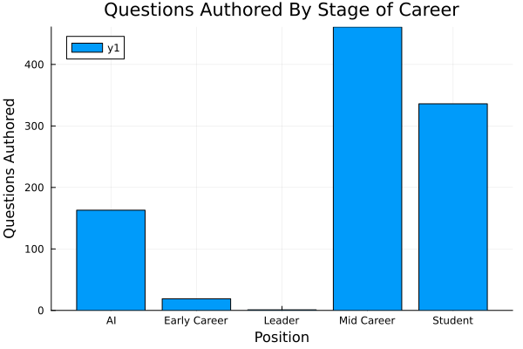
How Many Questions Did we Generate?
Between AI, Students, and Staff, we have generated about 980 questions so far in total.
In the same time, we have generated about 605 reviews
We have about 6 “Leaders” senior staff, we exclude them most of the time due to lack of data

Slide 7
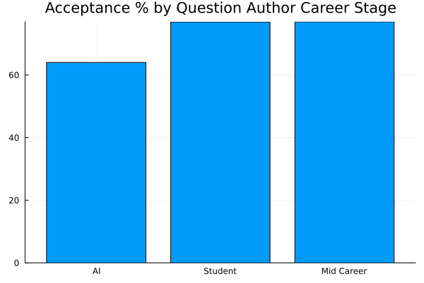
Does Author Stage of Career Matter for Question Quality?
Students and Staff produce questions that are accepted at roughly the same rate
AI generated questions tend to be accepted 14 %points less often.
There are possible improvements we could implement to the question generation method

Slide 8
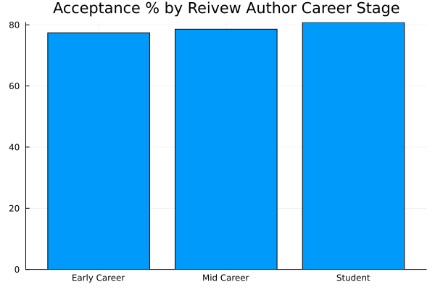
Does Reviewer Career Stage Effect Reviews?
Both Early Career, Mid Career Staff, and Students have very similar acceptance rates
This suggests our rubric is likely doing a good job
This also means we don’t have to always get senior folks to review, we can use students and junior staff.

Slide 9
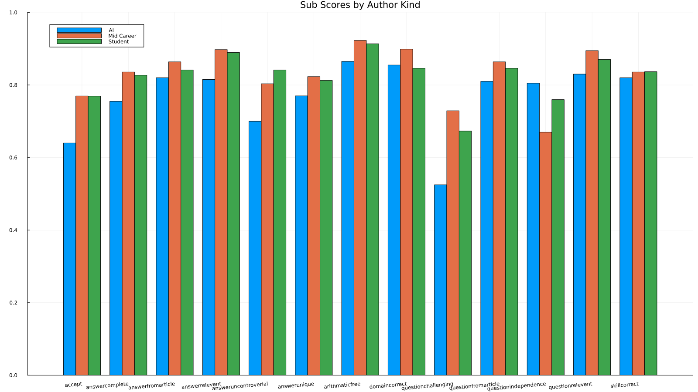
Detailed Score Breakdown
However, AI really struggles to make hard questions

Slide 10
Detailed Score Breakdown
Across the board, staff tend get higher quality scores to students, but similar acceptance

Slide 11
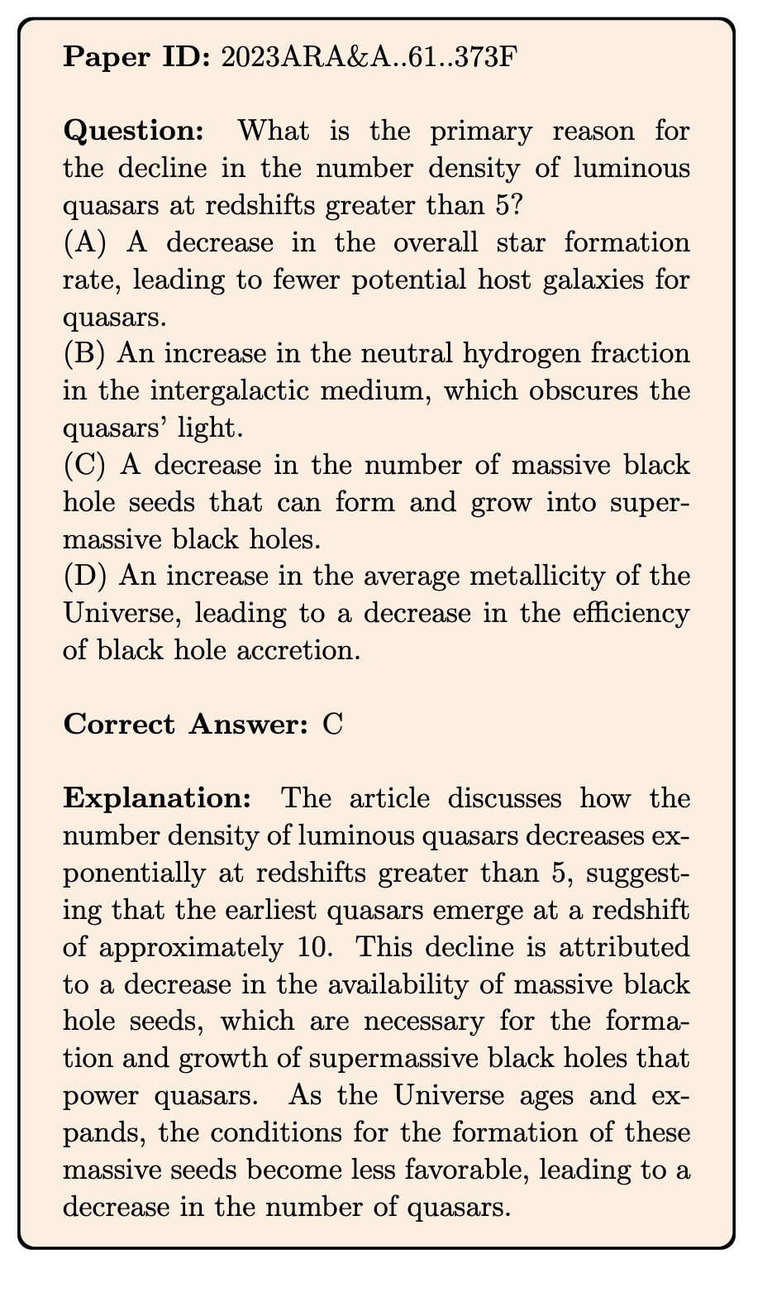
HOW DO WE WANT TO EVALUATE?
How to generate Multiple Choice Questions
Fully automatically (our work)
Collected 885 articles in Annual Review of Astronomy and Astrophysics, 1963 to 2023.
Used the Nougat optical character recognition (OCR) tool (Blecher et al. 2023) to transcribe these papers into text.
Fed each paper into Gemini-1.5-Pro and instructed it to propose 5 questions that can be answered based on the paper’s content.
Each question was accompanied by four options (A, B, C, D) only one of which is correct.
Robustness considerations added to the prompt generating the questions
Ting et al. (2024). Who Wins Astronomy Jeopardy
Notes:
Use Gemini 1.5 Pro to generate questions and answers based on this prompt
Iterate a few times with the instructions. Important to note that Gemini tends to make the correct answer the longest, so need to be explicit about equal lengths.
Also important to expand any acronym, and not refer to the original article because the questions are intended to be asked independently.
We prompted the model with three important instructions: (1) make the question specific enough to the article’s content but general enough so that it can later be asked independently; (2) also make the an- swer general enough, e.g., by refraining from pointing to specific sections of the article; and (3) ensure that the four answers are about the same in length, which stems from our earlier review that the model tends to pro- pose the correct answer to be the longest. Additionally, the model was tasked with providing an explanation and cited paragraphs from the review supporting the answer.

Slide 12
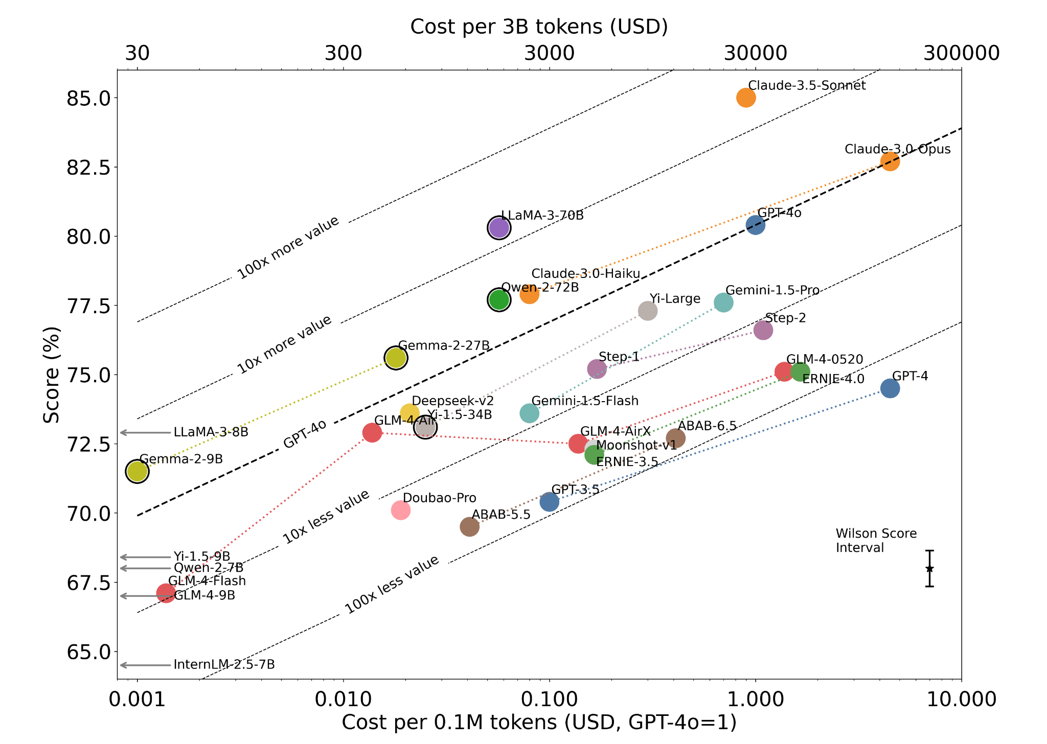
ASTRO BENCHMARK
Evaluation on N = 4,425 MCQs
x-axis show the cost per 0.1 million tokens
y-axis shows performance
Generally, within a series, there’s a 10-fold cost increase for a 3.5-point accuracy improvement
Claude-3.5-Sonnet outperforms others models.
LLaMA-3-70B is the only model in the same tier, albeit with lower performance.
Inference cost vs. performance
Notes:
Cost and performance trade-off in astronomical Q&A.
The dual x-axes show the cost per 0.1 million tokens and the cost to process an ArXiv astro-ph worth of tokens (∼3B tokens).
We use the average of input and output token costs based on June 2024 prices
Models with an outer circle indicate open- weights models run on low-cost APIs, leveraging recent specialized GPU developments for transformers.
Left arrows indicate cheaper open-weights models below the plot’s lower bound.
Models with an outer circle indicate open- weights models run on low-cost APIs, leveraging recent specialized GPU developments for transformers. Left arrows indicate cheaper open-weights models below the plot’s lower bound. Dotted lines of the same color connect models of the same series. Generally, within a series, there’s a 10-fold cost increase for a 3.5-point accuracy improvement
Dotted lines of the same color connect models of the same series. Generally, within a series, there’s a 10-fold cost increase for a 3.5-point accuracy improvement
Models with an outer circle indicate open- weights models run on low-cost APIs, leveraging recent specialized GPU developments for transformers. Left arrows indicate cheaper open-weights models below the plot’s lower bound. Dotted lines of the same color connect models of the same series. Generally, within a series, there’s a 10-fold cost increase for a 3.5-point accuracy improvement

Slide 13
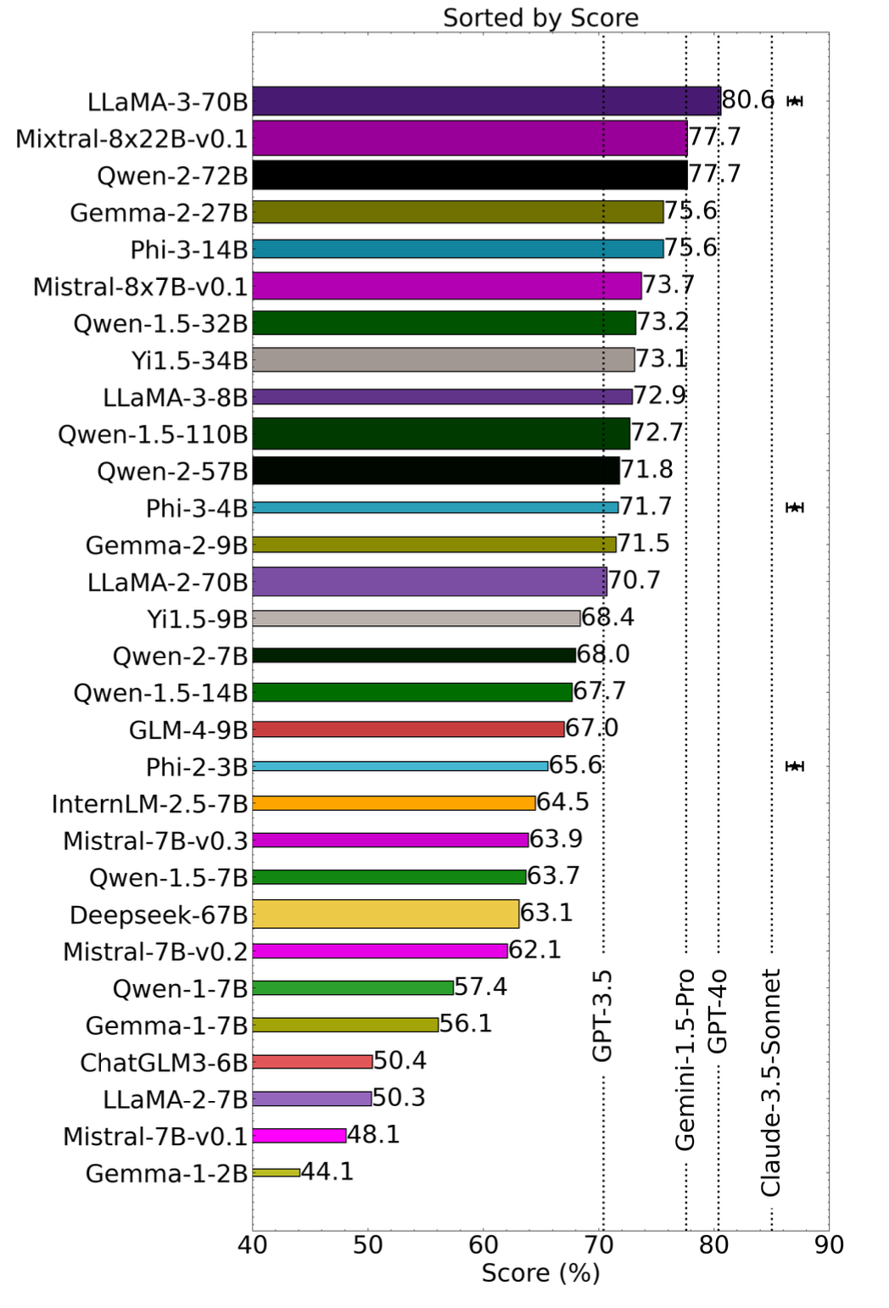
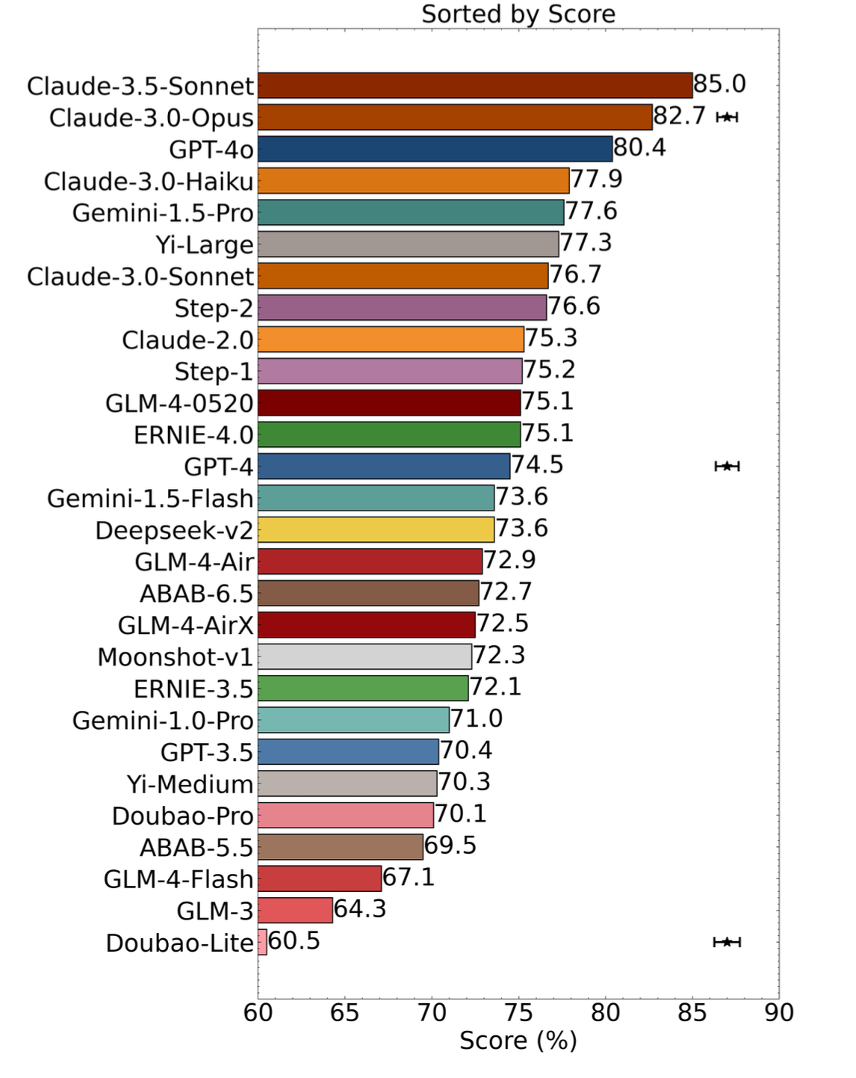
ASTRO BENCHMARK
4.6
Open source models in the 70B and above competitive for astronomical Q&A
Sub-areas in astrophysics
Notes:
Interestingly, while many cutting-edge models perform similarly in general benchmarks, they show significant variability in this niche astronomical research question-answering task
Claude-3.5-Sonnet performs best with an 85.0% accuracy, outperforming the closest non-Anthropic competitor, GPT-4o, by 4.6 percentage points.
LLaMA-3-70B performs best with an 80.6% accuracy, outperforming even GPT-4o (80.4%) and Gemini-1.5-Pro (77.6%), although it is still worse than Claude-3.5-Sonnet (85.0%).
Qwen-2-72B and Mixtral-8x22B-v0.1 are also competitive with 77.7% accuracy, which is on par with Gemini-1.5-Pro.
This shows that open-weights models, at least those with 70 billion parameters or more, are competitive in terms of astronomical Q&A performance.

Slide 14
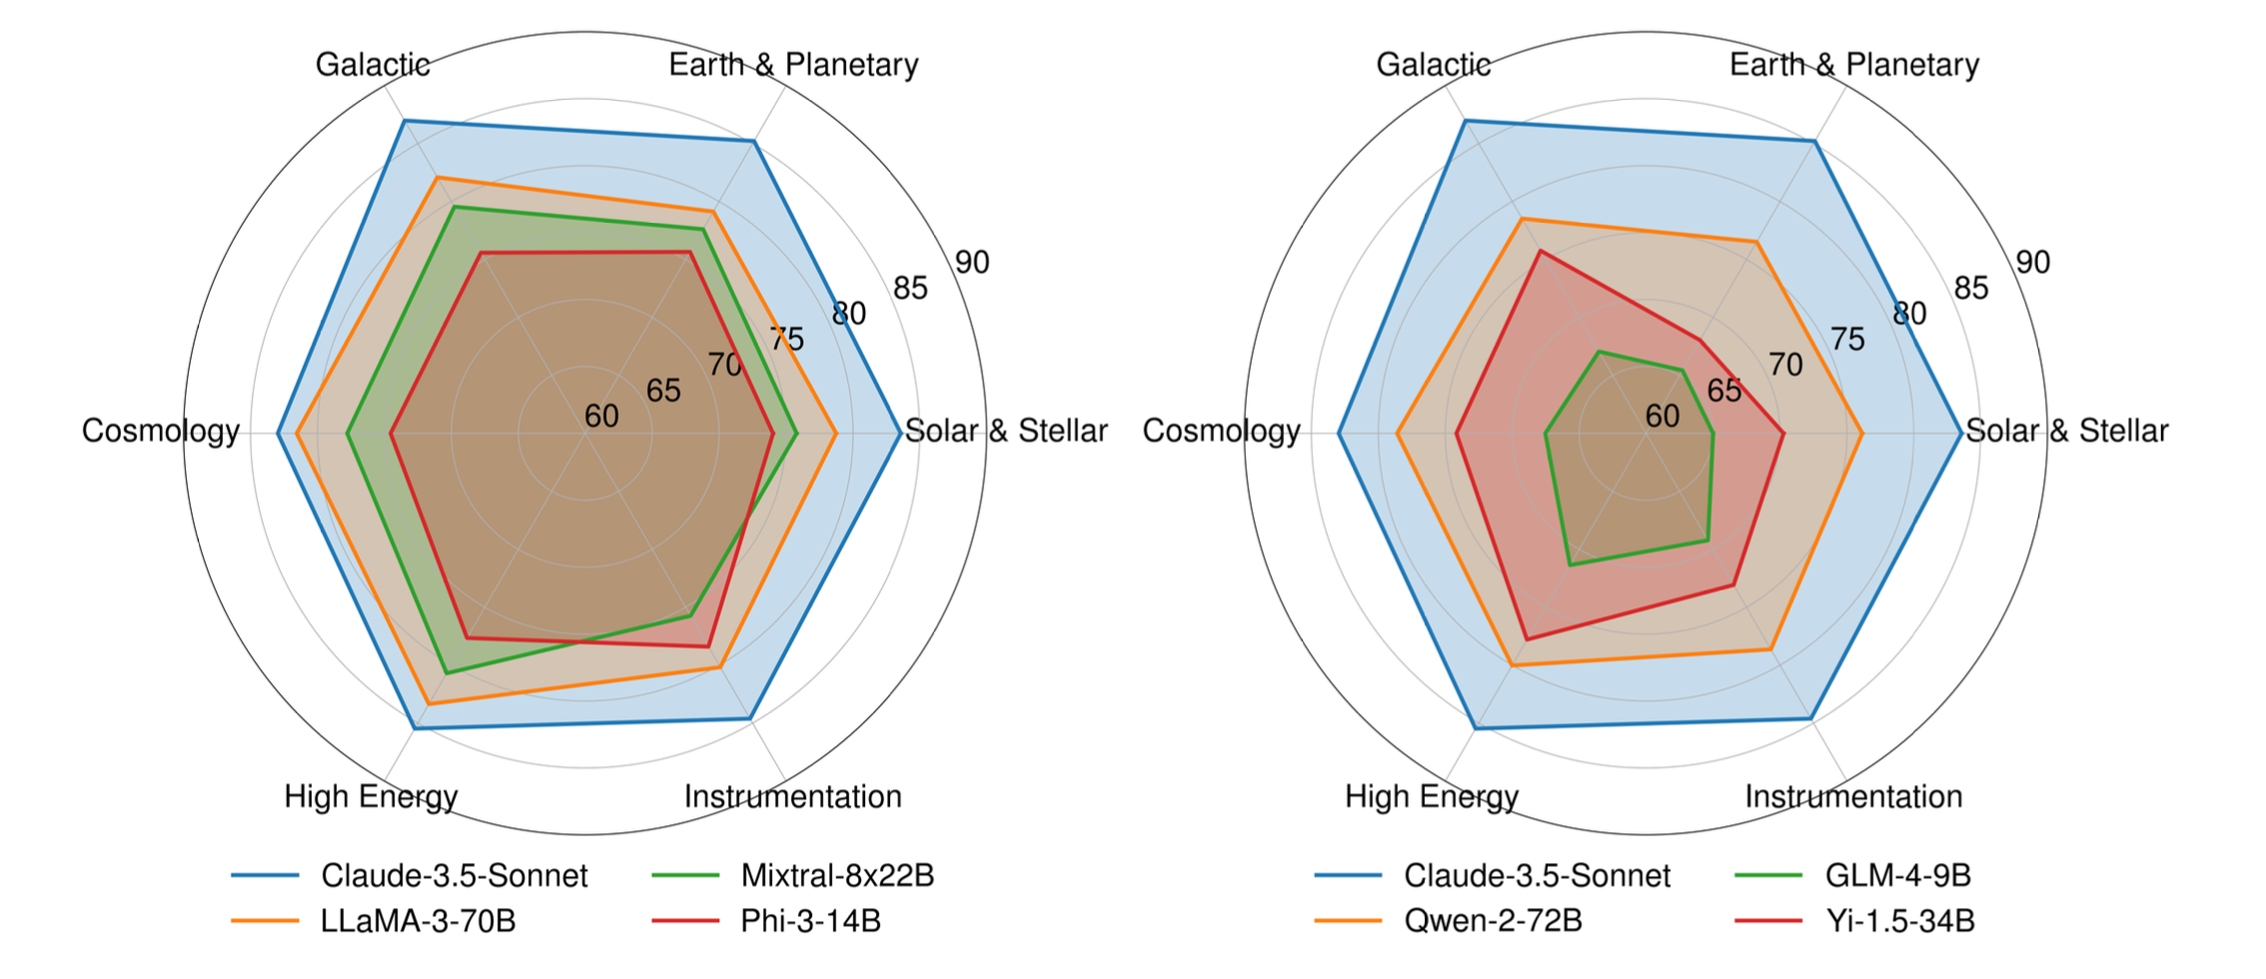
ASTRO BENCHMARK
Sub-areas in astrophysics
performance degradation in more recent topics
English-focused models
Non-English-focused models

